Slide 1
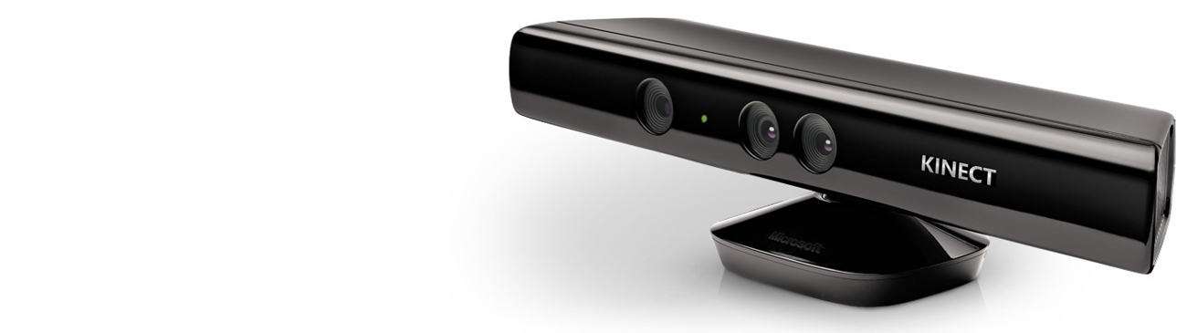

QUICKSTART SERIES

Slide 2
SETTING UP
YOUR DEVELOPMENT
ENVIRONMENT

Slide 3
QUICKSTART SERIES
Installing and Using the Kinect Sensor
Setting up your Development Environment
Camera Fundamentals
Working with Depth Data
Skeletal Tracking Fundamentals
Audio Fundamentals

Slide 4
KINECT API BASICS
Manage Kinect state
Connected
Enable Color, Depth, Skeleton
Start Kinect
Get Data
Events - AllFramesReady
Polling – OpenNextFrame

Slide 5
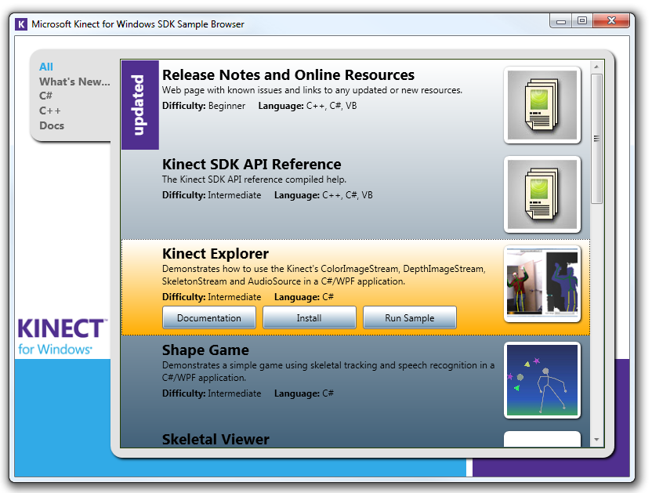
RESOURCES
Install Kinect Explorer
KinectWpfViewers
Coding4Fun Toolkit
Skeletal scaling

Slide 6
SETTING UP YOUR DEV ENVIRONMENT
DEMO

